Slide 1

A Final Project Report on
Connecting Us | Web-Based Chat Application
Submitted in Partial Fulfillment of the Requirements for the Degree of Bachelor in Software Engineering Under Pokhara University
Submitted by: -
Mr. Alishan Bhujel, CRN 191606 Mr. Prahlad Timalsina,CRN 191627
Under the supervision of Dr. Roshan Chitrakar Date: 7th November 2022
Department of Software Engineering
NEPAL COLLEGE OF INFORMATION TECHNOLOGY
Balkumari, Lalitpur, Nepal.

Slide 2
CONNECTING US
ACKNOWLEDGMENT
I am writing to express my profound gratitude to our Project Manager, Prof. Dr. Roshan Chitrakar, for his contributions in providing suggestions, guidance, and encouragement which helped us to complete our project titled Connecting Us.
My special thanks to our mentor Mr. Nipesh Shrestha for the time and effort he provided throughout the project. Your sound advice and suggestions benefited us during the project’s completion. In this aspect, I am eternally grateful to you.
We would also like to thank our families and friends, who helped us in every possible way.
This project was completed entirely by us and not by someone else.
Alishan Bhujel
Prahlad Timalsina
CRN: 191606
CRN: 191627

Slide 3
CONNECTING US
ABSTRACT
Connecting students through the internet is an essential aspect of the learning phase. Online communication allows users to communicate with like-minded people quickly and conveniently. This web-based application will be able to share texts, images, and other files in real time with little to no delay. It has direct and group chat features, which can edit and delete messages. The Connecting Us Chat system will be available on the web platform, which is platform-independent. Connecting Us is created to provide a real-time solution for different faculties' college students to connect, explore, share and discuss ideas related to events for personal growth, community services, planning, and executing those ideas in the real world. Users can log into the web application chat system and host multiple chat rooms at once, which can be filtered by their interests. As the application is web-based, there is no requirement to install the application. A robust JavaScript runtime environment Node.js with Express.js, is used to build up the entire backend development. Similarly, React, a JavaScript library is used for building user interfaces and frontend rendering. Get Stream API makes, connects, and stores users to the database.
Keywords: Node.js, React, Get Stream, Web-Based, Connect, Explore, Share, Idea.

Slide 4
CONNECTING US
CONTENTS
INTRODUCTION 5
  MOTIVATION AND PROBLEM STATEMENT 5
  PROJECT OBJECTIVES 6
  PROJECT SCOPE AND LIMITATIONS 6
  SIGNIFICANCE OF STUDY 6
LITERATURE REVIEW 7
  INTRODUCTION 7
  CURRENT SYSTEM 7
    MESSENGER 7
    SKYPE 8
METHODOLOGY 9
  SOFTWARE DEVELOPMENT LIFECYCLE 9
    ANALYSIS PHASE 10
    DESIGN PHASE 10
    CODING PHASE 10
    TESTING PHASE 10
  TECHNOLOGIES TO BE USED 10
  FUNCTIONAL AND NON-FUNCTIONAL REQUIREMENTS: 10
    FUNCTIONAL REQUIREMENTS 10
    NON-FUNCTIONAL REQUIREMENTS 12
  USE CASE TABLE 13
  CHAT ARCHITECTURE 14
  TOOLS TO BE USED 15
PROPOSED OUTPUT 16
PROJECT TASK AND TIME SCHEDULE 16
FINAL OUTPUT 18
CONCLUSION 19
BIBLIOGRAPHY 20

Slide 5
CONNECTING US
1. INTRODUCTION
Connecting Us is a web-based interactive chat application that is built to fill the communication gap between students at the college level. It enables like-minded students to create a group, discuss, plan and execute ideas to enhance their learning phase or solve ongoing college problems.
  MOTIVATION AND PROBLEM STATEMENT
The evolution of internet technologies has benefited people in accessing the web quickly. Communication between students using the internet is an essential part of the learning phase in their daily life. Face-to-face communication seems challenging to conduct for students of different faculties. The ongoing method to get notified of events and participation is through college-based email IDs, which seems inefficient and needs real- time service. Despite the effort made by Staff, using such a traditional method to engage the students has reduced the chance of participation in educational events. So, a chat application is essential for communication between students and staff. A few issues arise when the student wants to participate in such circumstances using the traditional method.
    Not everyone checks their email regularly, so there is a high chance of missing out on such events.
    It doesn’t allow students to interact with each other and discuss similar interests and their roles in participation.
    Each department email is produced by their respective Head of Department, involving only a specific department.
    The essence of real-time communication is lost.

Slide 6
CONNECTING US
  PROJECT OBJECTIVES
    To create a chat application with a server and to enable the students from different faculties and semesters to plan, coordinate and execute ideas with each other.
    To develop an instant messaging solution to enable users to communicate with each other seamlessly.
    To make students connect anywhere, anytime, to anyone of their interests.
    To ensure chat security and authentication.
  PROJECT SCOPE AND LIMITATIONS
This project will be developed as a web-based chat application. The project is planned to introduce an online web chat system solution for students. Furthermore, a real-time communication chat system will be included as a feature. There are additional features included in the project, such as file sharing and text chat. Besides that, an SMS notification system will be developed to notify the users of any messages. However, the mobile site will not cover the real-time communication web application.
Although it has some limitations of uses, they are:
    Users should have access to the internet.
    Users must register first and log in to access this website.
  SIGNIFICANCE OF STUDY
The research conducted to develop this chat application reveals students’ collaboration difficulties. The findings would be significant in assessing how communication between students can be essential while promoting collaboration and increasing student participation. A collaborative platform that allows students of similar interests to discuss with each other would help the faculty and students resolve various needs, such as finding teammates for the events or just making new friends. A healthy relationship and collaboration among the students will prove fruitful for the college.

Slide 7
CONNECTING US
LITERATURE REVIEW
  INTRODUCTION
Building the system will require us to study and analyze the existing systems. This would help us identify the current system's difficulties and problems. It also helps to analyze the pre-existing situation and provide a clear view of the user requirements, propelling a better-performing system.
  CURRENT SYSTEM
Most chat rooms available today are integrated for the general public. It doesn’t specify the current needs of college students to connect with the right people. It is mainly used in unproductive agendas and lacks the motivation and persistence to achieve specific goals.
Example of chat rooms:
    MESSENGER:
These chat rooms are a great place to meet and communicate with friends who share your interests. The main advantages and disadvantages of these rooms are:
Advantages:
      It offers the possibility to meet people from all over the world that share common interests on topics such as music and entertainment, politics and religion in a safe and non-threatening environment.
      Communicating with people directly on a virtual platform saves time.
3. Participating on an online platform doesn’t involve judgment upon
appearance.
Disadvantages:
1. Username and other essential details might not be accurate. Anonymity can falsify chat room groups, which can be used as a platform to promote harassment by predators.

Slide 8
CONNECTING US
2. The content that appears in the chat may not be controlled or filtered in any way.
    SKYPE:
Skype voice chat uses voice over IP (VoIP) protocol to allow people worldwide to communicate. It requires individuals to pay for credit when they call landlines and cell lines. The advantages and disadvantages of using Skype are as below:
Advantages:
      It is free to use for users having a Skype account.
      Send and receive messages and files.
Disadvantages:
No constraints on the registration of the account. One email id can be used to open multiple accounts.
Skype can facilitate cyberbullying, especially since the activities are not monitored.

Slide 9
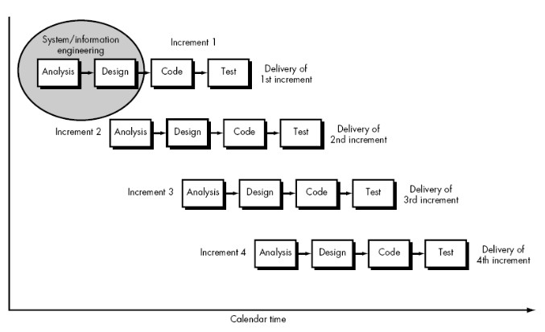
CONNECTING US
3. METHODOLOGY
We plan to work on this project using the methodologies described below to apply our knowledge, skills, tools, and techniques to meet the requirements of our project, Connecting Us.
3.1 SOFTWARE DEVELOPMENT LIFECYCLE
The framework we will be using for developing this project is the Incremental model. This model combines the linear sequential model with the iterative prototype model. New functionalities will be added as each increment is developed. The phases of the linear sequential model are Analysis, Design, Coding, and Testing. The software repeatedly passes through these phases in iteration, and an increment is delivered with progressive changes.
Figure 1: Incremental Model

Slide 10

CONNECTING US
    ANALYSIS PHASE
The analysis will be performed in this phase to determine the system’s requirements. The outcome of this phase would be an SRS, an acronym for “System Requirement Specifications.”
    DESIGN PHASE
The SRS would be translated into the system’s design in this phase. Context Diagram, DFD, ER –Diagram, Use Case Diagram, and Class Diagram will be developed.
    CODING PHASE
In this phase, coding will be done according to the design, and a working system will be developed by the end of this process.
    TESTING PHASE
In this phase, the system will be tested. With each test, a list of changes to the system developed is suggested. The changes will be applied to the software and delivered in successive increments until a satisfying system is achieved.
  TECHNOLOGIES TO BE USED
CSS and HTML to develop interactive user interfaces.
JavaScript (React with JSX) adds user interaction for event handlers and behaviors. Node.js, Express.js, for server-side validation and retrieval.
Get Stream API for the database for storing all the application data.
  FUNCTIONAL AND NON-FUNCTIONAL REQUIREMENTS: -
    FUNCTIONAL REQUIREMENTS
      User Registration
10

Slide 11
CONNECTING US
Users must be able to register for the application through an Email, Username, and Password. On Opening the application, users must be able to register themselves or directly login if they have an account already. If the user skips this step, the user should be able to chat. The user’s email will be the unique identifier of their account on the Chat Application.
II. Adding New Contacts
The application should detect all contacts from the server database. If any contacts have a user-entered with Chat Application, those contacts must automatically be added to the user’s contact list on Chat Application.
III.
Send Message:
Users should be able to send instant messages to any contact on their Chat Application contact list. Users should be notified when a message is successfully delivered to the recipient by coloring the letter.
IV. Broadcast Message:
The user should be able to create groups of contacts. Users should be able to broadcast messages to these groups.

Slide 12
CONNECTING US
3.3.2 NON-FUNCTIONAL REQUIREMENTS
1. Privacy:
Messages shared between users should be encrypted to maintain privacy.
Robustness:
If the user’s system crashes, a chat history backup must be stored on remote database servers to enable recovery.
Performance:
The application must be lightweight and send messages instantly.

Slide 13
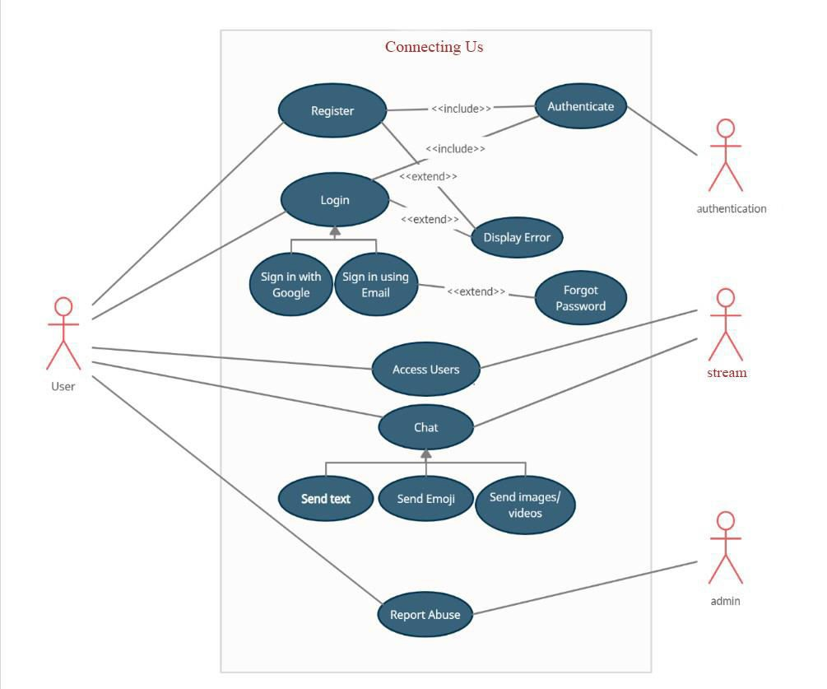
CONNECTING US
3.4 USE CASE TABLE

Slide 14

CONNECTING US
  CHAT ARCHITECTURE
A chat consists of two major parts:
    Client part, which is a Web chat application. Build on React
Component:
Components are the building blocks of any React app, and a typical React app will have many of these. Simply put, a component is a JavaScript class or function that optionally accepts inputs, i.e., properties(props), and returns a React element that describes how a section ofthe UI (User Interface) should appear.
lists the packages your project depends on
specifies versions of a package that your projectcan use.
makes your build reproducible and easier to share with other developers.
A package.json file:
      lists the packages your project depends on
      specifies versions of a package that your projectcan use.
      makes your build reproducible and easier to share with other developers.
    Server part:
It is a pool of external servers responsible for the chat operation. This is the place where all the chat magic happens. This is a core of the chat architecture that handles message delivery and dispatch.
Dependencies

Slide 15
CONNECTING US
The third-party package or module installed using npm is specified in this segment. The package.json file is the heart of the Node.js system. It is the manifest file of any Node.js project and contains the project’s metadata. The package.json file is essential to understanding, learning, and working with Node.js. It is the first step to learning about development in Node.js.
3.6 TOOLS TO BE USED
The tools used for documentation, designing, developing UI/UX, and testing are:
TOOLS | PURPOSE
Figma | Designing UI/UX
React with JSX, CSS | For frontend web application development
Visual Studio Code | Text editor for code, markup, and prose
Adobe Photoshop CC 2021 | Design
Node.js, Express.js | For backend web application development
Table 1: Tools to be used

Slide 16
CONNECTING US
PROPOSED OUTPUT
Connecting Us, in its final phase, will be able to provide users with the features and information that with the following results:
  Students of different faculties can communicate with each other, including the lecturers.
  It will consist of a Login, Registration form, and Chat Dashboard.
  After registration, the data will be added to the database, and the user can finally sign in.
  We can add reactions to the messages and send emojis.
  We will be able to reply to specific messages.
  Searching for different users will be available.
5. PROJECT TASK AND TIME SCHEDULE
The project schedule has been designed as per the requirements and constraints involved. This project is scheduled to be completed in approximately 30 days. Requirement analysis has been given more emphasis. Debugging and Testing will be done before the completion of the project.
TASK | APPROX DURATION(IN DAYS)
Requirement Analysis and Specification | 9
Undertake Analysis of the System | 3
Design System | 3
Coding | 10
Testing and Debugging | 3
Develop Documentation | 2
Table 2: Project Task and Schedule

Slide 17
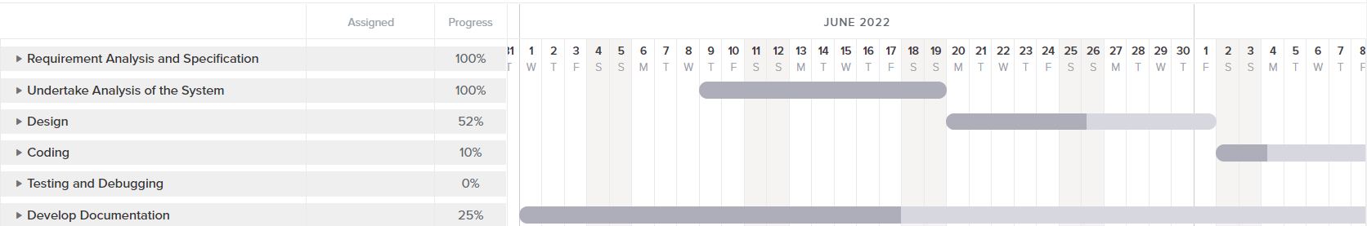
CONNECTING US
Figure 1: Gantt Chart

Slide 18
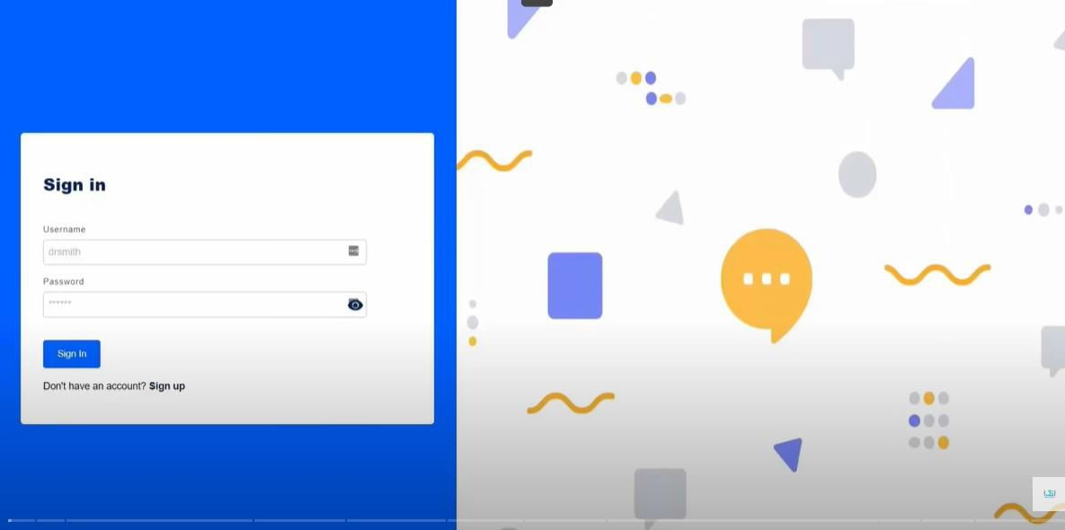
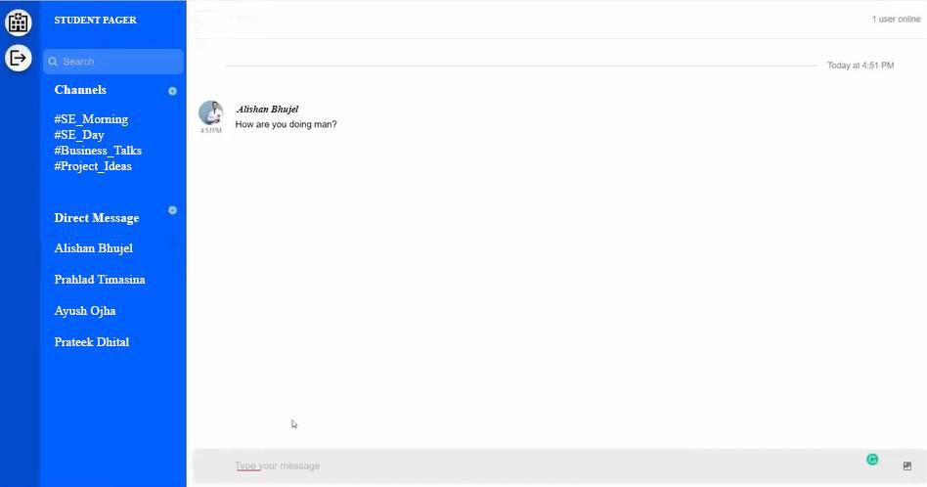
CONNECTING US
7. FINAL OUTPUT
Fig 2: Sign-In Page
Fig 3: Main Page

Slide 19
CONNECTING US
8. CONCLUSION
There is always room for improvement in any app. Right now, we are just dealing with text communication. Several chat apps serve similar purposes as this project, but these apps could have been easier to use and provided confusing interfaces. A positive first impression is essential in human relationships and inhuman-computer interaction. This project hopes to develop a chat service Web app with a high-quality user interface. In the future, we may be extended toinclude features such as:
File Transfer
Audio Call
Emojis
Group Call
Notifications

Slide 20
CONNECTING US
BIBLIOGRAPHY
  Arnold, J. and Kaske, N. . Evaluating the quality of a chat service. Portal: Libraries & the Academy, 5: 177–193. [Crossref], [Web of Science
®], [Google Scholar]
  Bobrowsky, T., Beck, L. and Grant, M. . The chat reference interview: Practicalities and advice. The Reference Librarian, 89/90: 179–
191. [Google Scholar]
  Childers, T. 1978. The effectiveness of information service in public libraries: Suffolk County: Final report, Philadelphia, PA: Drexel University, School of Library, and Information Science. [Google Scholar]
4. | Express JS: | https://expressjs.com/en/guide/routing.html, https://www.javatpoint.com/expressjs-tutorial.
5. | NPM: | https://www.npmjs.com/
6. | ReactJS: | https://reactjs.org/docs/getting-started.html,
 |  | https://www.javatpoint.com/reactjs-tutorial,
 |  | https://www.tutorialspoint.com/reactjs/reactjs_overview.ht.
7. | NodeJS: | https://nodejs.org/en/docs/, https://www.javatpoint.com/nodejs-tutorial.
8. | WebSocket: | https://yellow.systems/blog/guide-to-the-chatarchitecture
9. | REST API: | https://www.toptal.com/nodejs/secure-rest-api-in-nodejs
20

